Slide 1


An introduction into the broad concepts of Artificial Learning and Machine Intelligence
DSCPESU
Introduction to Machine Learning
Beginner Track

Slide 2




Meet your speakers!
Mayank Agarwal
Sparsh Temani
Ishaan Lagwankar
Anaica Grouver

Slide 4

Let’s do some drawing with Google QuickDraw!
g.co/quickdraw

Slide 5
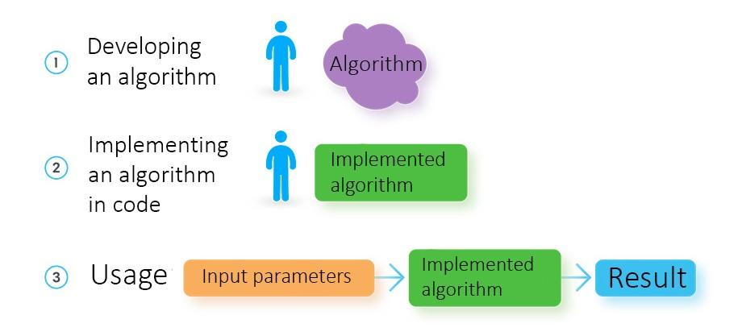
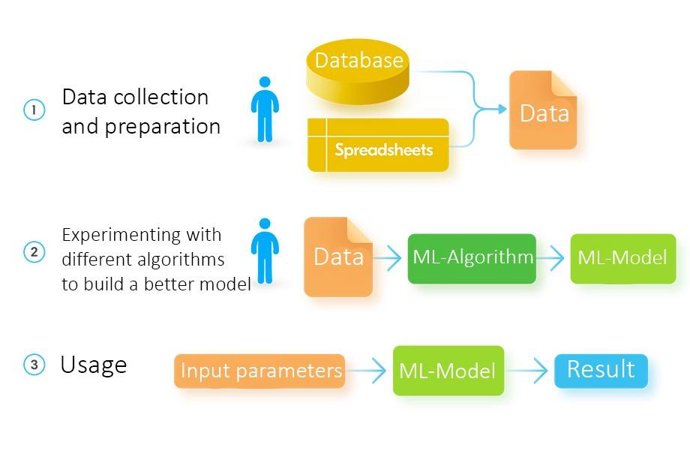
Traditional Programming vs Machine Learning
Traditional Programming
Machine Learning
Source: https://towardsdatascience.com/machine-learning-vs-traditional-programming-c066e39b5b17

Slide 6

So how does ML work?
Source: https://www.edureka.co/blog/what-is-machine-learning/

Slide 7
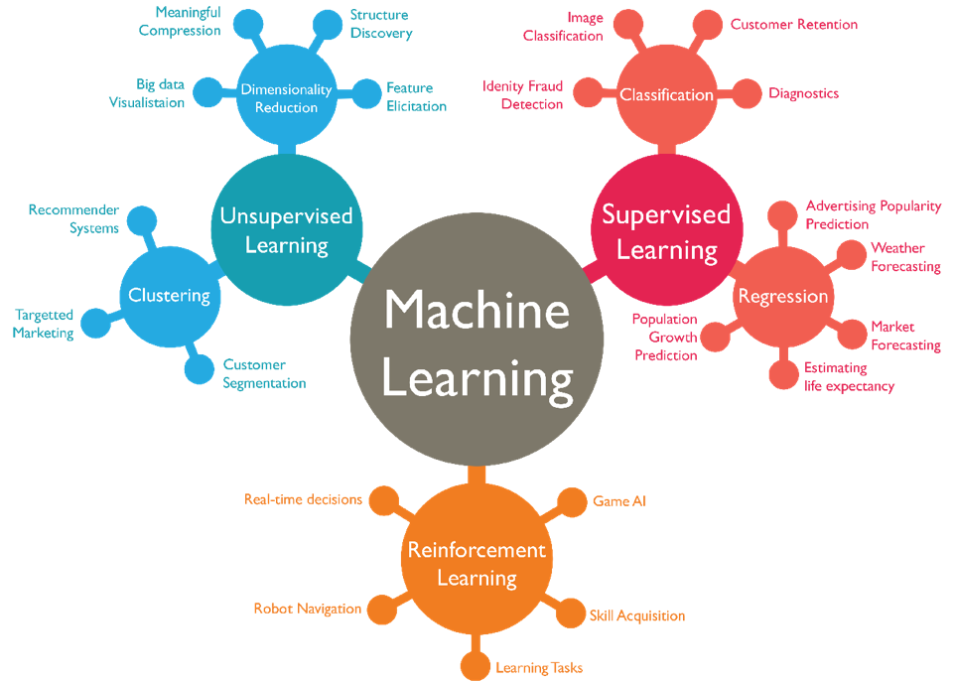
Types of Machine Learning
Supervised Learning
Regression
Decision Trees
Random Forests
Classification
KNN
Trees
SVM
Bayesian
Unsupervised Learning
Clustering
Reinforcement Learning
Q Learning

Slide 8
Let’s work it out! How can we use machine learning, powered by TensorFlow, to help doctors determine the likelihood of respiratory diseases?

Slide 9
Things to keep in mind!
Ideation. Align on the key problem to solve, and the potential data inputs to consider for the solution.
Data preparation. Collect and get the data in a useful format for a model to digest and learn from.
Prototyping and testing. Build a model or set of models to solve the problem, test how well they perform and iterate until you have a model that gives satisfactory results.
Productization. Stabilize and scale your model as well as your data collection and processing to produce useful outputs in your production environment.

Slide 11
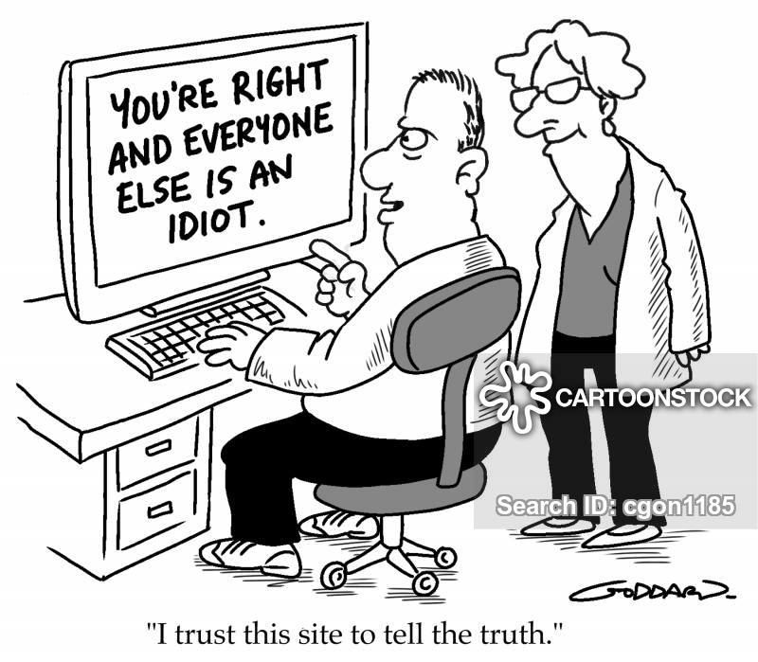
Machine Learning and Bias

Slide 12
How do we remove this bias?
Remove your own inherent bias!
Varied training data
Annotate data correctly
Check for implicit bias when you have an output!

Slide 13
And that’s a wrap to session 1!

